Slide 1

Toxic Comment Detection using BERT-based Multi-label Classification
Powered by Hugging Face Transformers and PyTorch
DEVELOPED BY: BALAJI K
DATE: JULY 2025

Slide 2
The Challenge of Online Content Moderation
Problem Statement
Volume: Billions of messages posted daily across platforms
Manual Review: Impossible to manually review all content
Context Sensitivity: Toxicity can be subtle and context-dependent
Multiple Categories: Different types of harmful content require different responses
Real-time Needs: Immediate detection and response required
Solution: Automated, intelligent toxicity detection system

Slide 3




Source: Guvi Toxic Comment Classification
Shape: 159,571 comments
Multi-label: A single comment may belong to multiple classes
Label Samples
Toxic 15%
Severe Toxic 1.9%
Obscene 10%
Threat 0.5%
Insult 9.8%
Identity Hate 1.8%
Dataset Overview

Slide 4


Challenges
Multi-label classification
Class imbalance (very low support for some labels)
Unstructured text with slang, misspellings
Need for scalable and generalizable solution

Slide 5

Solution Architecture
Model Used: BERT-base-uncased
Frameworks: PyTorch, Transformers
Key Components:
Custom BertMultiLabelClassifier
Tokenizer from pretrained model
Binary cross-entropy loss
Sigmoid activation for multi-label outputs

Slide 6

Data Split: Train (70%) / Test (30%)
Training Strategy
Hyperparameters:
Batch Size: 16
Max Length: 128
Epochs: 3
Optimizer: AdamW
Scheduler: Linear warmup
Class weights and weighted loss used to address imbalance

Slide 7
Model Evaluation Metrics
Metrics Reported
Precision, Recall, F1-Score (per label)
ROC-AUC for all labels
Micro, Macro, Weighted Averages
ROC-AUC Scores (selected)
Obscene: 0.992
Threat: 0.994
Insult: 0.987
Severe Toxic: 0.991

Slide 8
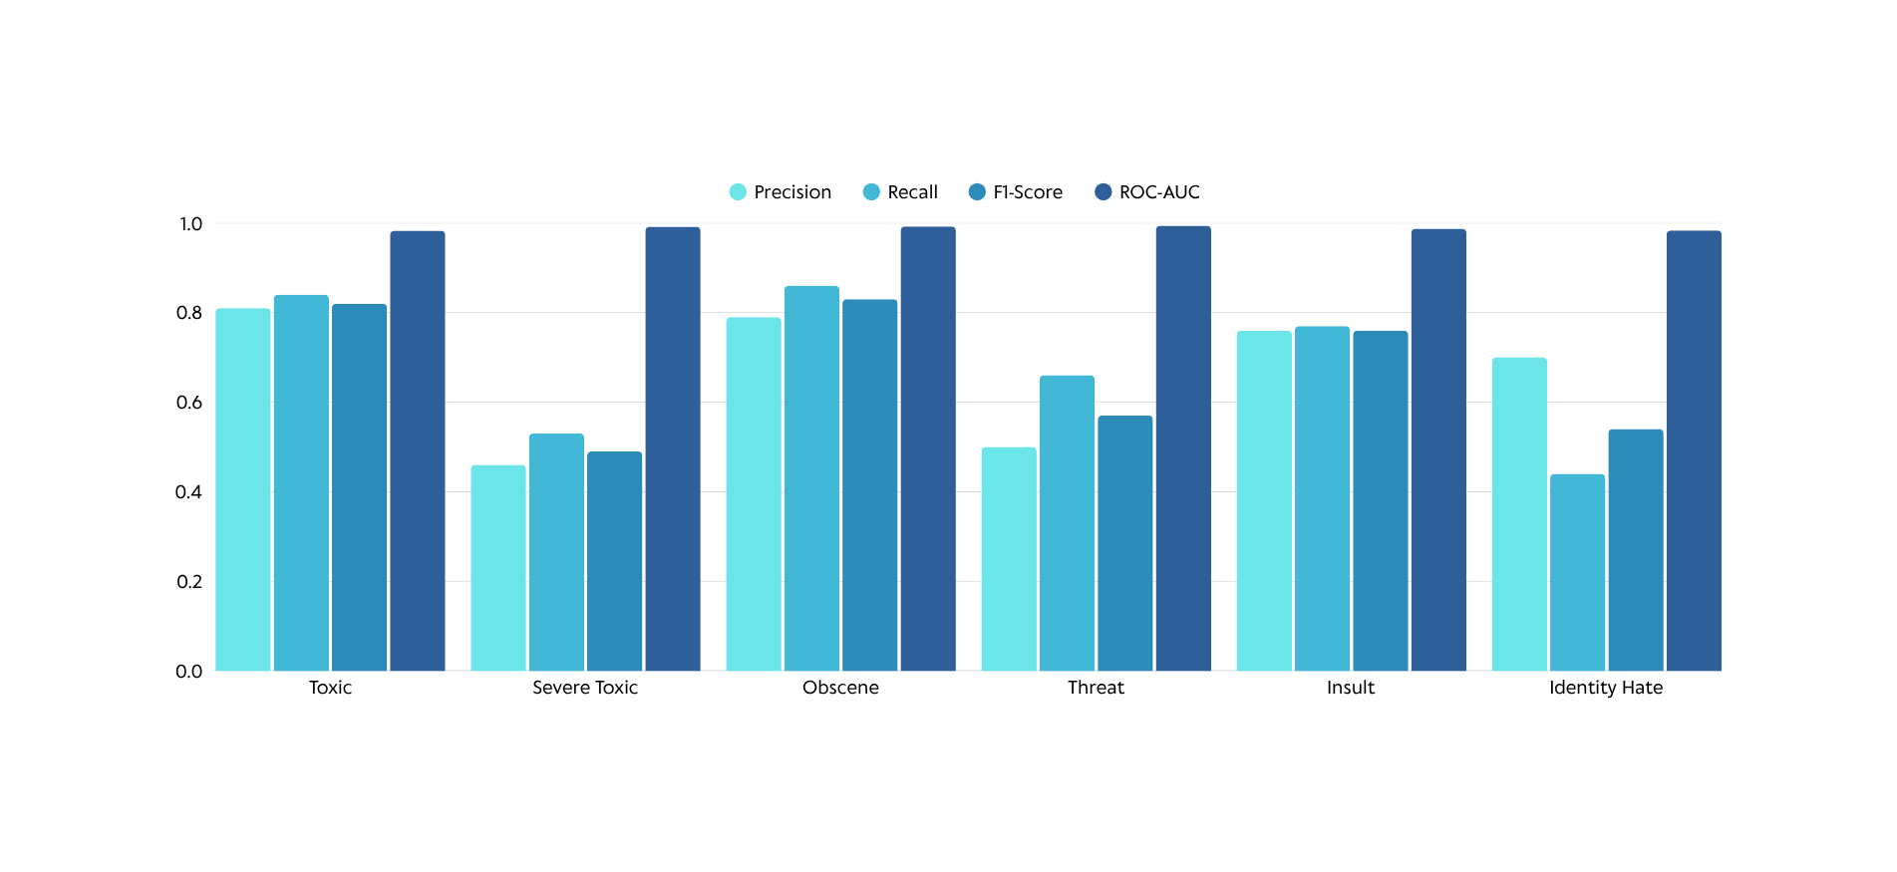
Model Performance Summary
Micro Avg F1: 0.78
Macro Avg F1: 0.67

Slide 9
Streamlit App
Features
Single & bulk comment prediction
CSV upload for batch processing
Visualizations (bar charts, histograms)
Downloadable analysis results
Beautiful UI with Plotly, responsive layout
Files Used
bert_multilabel_best.pth
label_list.json
./bert_tokenizer

Slide 10
GitHub & Deployment
Public GitHub Repo: https://github.com/Balaji-itz-me/Deep-Learning-for-Comment-Toxicity-Detection-with-Streamlit
Includes:
README.md with setup & usage
.py and .ipynb files
Pretrained weights, tokenizer, and sample CSV
Deployment:
Streamlit Cloud hosted app
Video Demo shared on LinkedIn

Slide 11
Key Learnings
Hands-on with Transformers (BERT)
Tackled multi-label classification
Managed deployment issues (tokenizer, Rust, Python versions)
Real-world app building and performance tuning

Slide 12
Fine-tune on more diverse datasets
Improve performance on low-frequency labels
Add moderation actions (like flags, user alerts)
Integrate model explainability (e.g., SHAP)
Next Steps

Slide 13


Thank you
Email
balajikamaraj99@gmail.com
LinkedIn
https://www.linkedin.com/in/balaji-k-626613157/

